Slide 1
Specific Aim 2: Fabrication of cdECM-NP Scaffolds
Objective: Investigating the effects of
The printing parameters (speed, pressure, and needle gauge) impact on 3D printed cdECM-NP scaffolds’ print quality as enabled by machine learning
cdECM-NP/GNP ratio and interparticle crosslinking density impacts their swelling and degradative properties
Hypothesis:
A 3D printer parameter tuning method will be successfully developed that relates user-controlled parameters for 3D printing the composite colloidal inks and the resulting scaffold print quality.
This composite colloidal ink platform will provide control over swelling behavior and degradation kinetics of the printed composite colloidal scaffolds by tuning the ink composition and scaffold crosslinking intensity.

Slide 2

Specific Aim 2: Fabrication of cdECM-NP Scaffolds
Study 2.1 | The combination method of partial factorials and bayesian optimization to optimize the 3D printing parameters of cdECM-NP/GNP composite colloidal ink and common tissue engineering materials
Composite colloidal inks per SA1
Each material will be 3D printed on Bioassembly Bot (BAB) into 2 layered 10 x 10 mm scaffolds
Groups | Speed | Pressure | Needle Gauge
1 | - | - | -
2 | + | - | -
3 | - | + | -
4 | + | + | -
5 | - | - | +
6 | + | - | +
7 | - | + | +
8 | + | + | +
Notes:
Training set , evaluating print quality

Slide 3
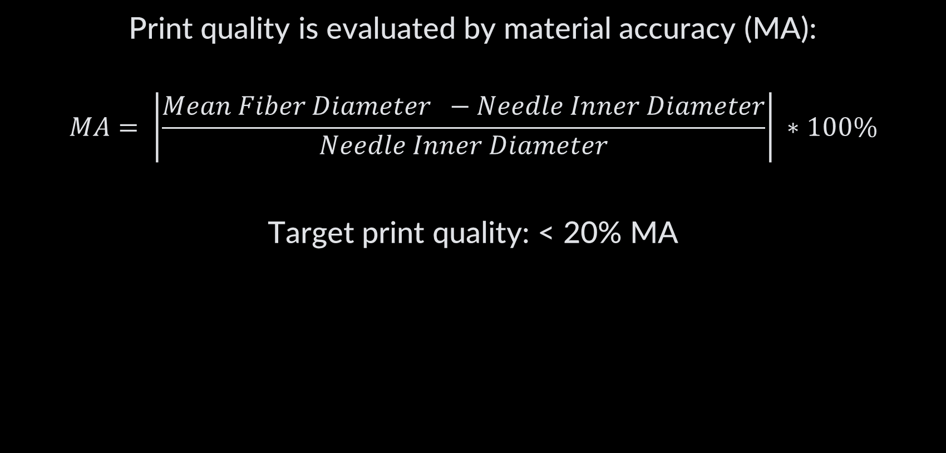
Specific Aim 2: Fabrication of cdECM-NP Scaffolds
Print quality is evaluated by material accuracy (MA):
$$MA= \left|\frac{Mean Fiber Diameter −Needle Inner Diameter}{Needle Inner Diameter}\right| ∗100\%$$
Target print quality: < 20% MA
Trachtenberg JE et al. J Biomed Mater Res A. 2014

Slide 4
Specific Aim 2: Fabrication of cdECM-NP Scaffolds
Study 2.1 | The combination method of partial factorials and bayesian optimization to optimize the 3D printing parameters of cdECM-NP/GNP composite colloidal ink and common tissue engineering materials
Composite colloidal inks per SA1
Each material will be 3D printed on Bioassembly Bot (BAB) into 2 layered 10 x 10 mm scaffolds
Groups | Speed | Pressure | Needle Gauge
1 | - | - | -
2 | + | - | -
3 | - | + | -
4 | + | + | -
5 | - | - | +
6 | + | - | +
7 | - | + | +
8 | + | + | +
Notes:
Training set , evaluating print quality

Slide 5
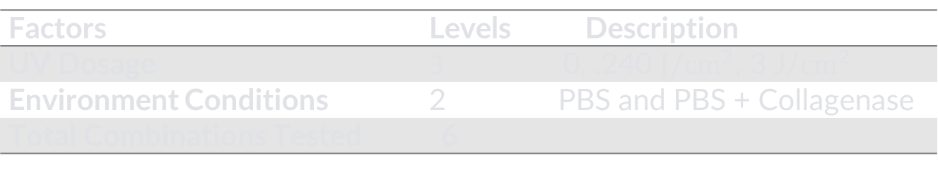
Specific Aim 2: Fabrication of cdECM-NP Scaffolds
Study 2.2 | Investigating the effects of interparticle crosslinking density on the physicochemical properties of 3D-printed GNP scaffolds
Degradation/Swelling Study:
Scaffolds mass and mechanical properties will be determined at 1d, 14d, 28d, and 35d
Non-porous and porous area determined at each time point: 1d, 14d, 28d and 35d
Factors | Levels | Description
UV Dosage | 3 | 0, .240 $J/{cm}^{2}$, 3 J/${cm}^{2}$
Environment Conditions | 2 | PBS and PBS + Collagenase
Total Combinations Tested 6
Notes:
Using the printing parameters from study 2.1, composite colloidal ink scaffolds are fabricated according to the levels in the table

Slide 6
Specific Aim 2: Fabrication of cdECM-NP Scaffolds
Study 2.3 | Investigating the effects of interparticle crosslinking density and cdECM-NP/GNP ratio (cdECM dose) on the physicochemical properties of 3D printed cdECM-NP/GNP composite scaffolds
Degradation/Swelling Study:
Scaffolds mass and mechanical properties will be determined at 1d, 14d, 28d, and 35d
Scaffold biochemical properties will be determined at 1d and 35 d
Non-porous and porous area determined at each time point: 1d, 14d, 28d and 35d
Factors | Levels | Description
GNP:cdECM-NP Ratio | 3 | 100:0, 90:10, 80:20
UV Dosage | 2 | Values from Study 2.2
Environment Conditions | 2 | PBS and PBS + Collagenase
Total Combinations Tested 6
Notes:
Using the printing parameters from study 2.1, composite colloidal ink scaffolds are fabricated according to the levels in the table

